Slide 1
Announcement Services
GS Program Official
Instructor-Led Training

Slide 2
Agenda
Introductions
Setting the Stage
GrantSolutions Overview
Announcement Services Overview
Training Objectives
Training

Slide 3
Setting the Stage
Housekeeping:
  We will use the Teams Chat box to for Knowledge Checks/Participant Engagement and Q&As
  Please mute your phones/mics to reduce background noise
The Announcement Services training course is:
An overview of how Program Official duties are performed within Announcement Services
An overview to teach how to review the full NOFO
An opportunity to write down any question(s) identified during class. Time will be allotted for Q&A.
An opportunity to document business process questions to discuss with Agency Leads
The Announcement Services training course is NOT:
An opportunity to discuss enhancements or changes to the GrantSolutions Announcement Services system
A platform to discuss business process changes

Slide 4
Announcement Services Overview

Slide 5




Grants Life Cycle
Create, Approve
& Publish
Notice of Funding Opportunity (NOFO)
in AM
Conducts Merit Review
In ARM
Prepare, Approve, Issue Awards
In GMM
Closeout
In GMM
Process
Applications
In GMM
Assess
Applicant Risk
In GMM
Amend Awards
(Mods)
In GMM
Data Visualizations and Analytic Business Intelligence (BI) tools
Announcement Services
BI Dashboard tools for all GS data
Grants Management Services
Application Review Services

Slide 6
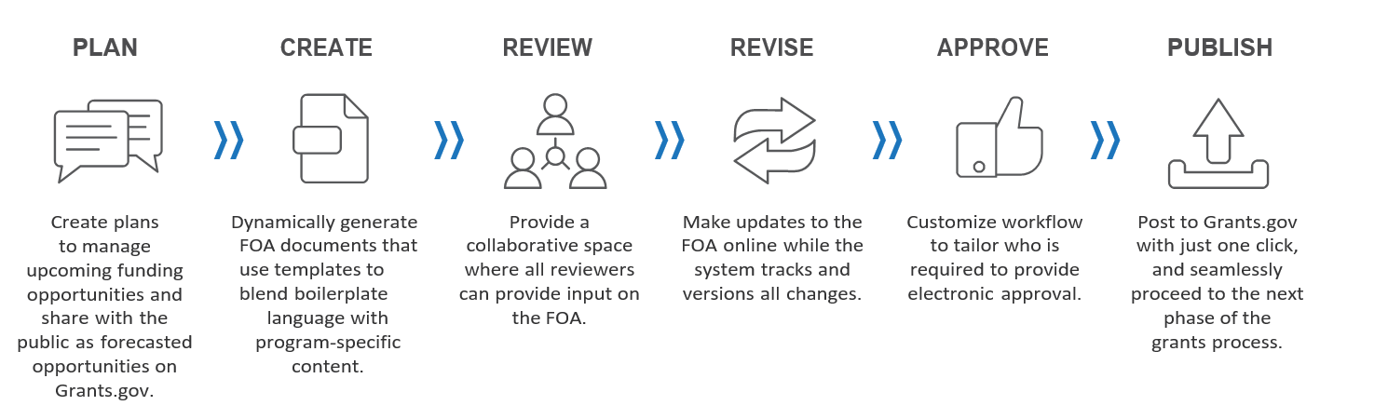
Announcement Services Process
Purpose
Streamlines the Notice of Funding Opportunity (NOFO) planning, creation, approval, and publication process
Notes:
Speak to the different phases (forecast, creation, review and approval, publication)

Slide 7
Benefits
Document Integrity, Efficiencies
NOFO templates provided to reduce Author(s) efforts and ensure document quality
Only one working copy of the NOFO with custom editing limitations
Traceability, Transparency
Automatic notifications and custom reminders
Automated process that shows past, present and future stages
Data Quality, Data Analytics
Seamless integration with Grants.gov and GMM
Data shared across NOFO document, reducing double-data entry
BI Reporting

Slide 8
Training Objectives

Slide 9

Training Objectives
Actions | AS Role | IHS Role
Review NOFO. | GS Program Official | Program Director
Review NOFO
Complete Task

Slide 10
System Training

Slide 11
Knowledge Check

Slide 12
Knowledge Check
Check your knowledge by responding in the Teams Chat box.
Where is the full NOFO located in Announcement Services?
  Key Attributes Tab
  Publication Setup Tab
  Dashboard Tab
  Announcement Tab
Respond to the knowledge checks using the Teams Chat box.
Have questions? Post them in the Q&A box so we don’t miss them.

Slide 13
Knowledge Check
Check your knowledge by responding in the Teams Chat box.
What template language cannot be changed by the user?
  Standard Language
  Program Specific Language
  Drafter Instructions
  Both A and C
Respond to the knowledge checks using the Teams Chat box.
Have questions? Post them in the Q&A box so we don’t miss them.

Slide 14
Knowledge Check
Check your knowledge by responding in the Teams Chat box.
An unaddressed comment will be:
  Red
  White
  Green
  None of the Above
Respond to the knowledge checks using the Teams Chat box.
Have questions? Post them in the Q&A box so we don’t miss them.

Slide 15
System Access

Slide 16
Announcement Services Access after Training
Once a role request has been submitted by your agency
You will receive 2 separate emails containing your:
GrantSolutions Welcome Email
AS Account Creation information
You MUST:
Log into GrantSolutions within 60 days
Accept AS’s eRA/IMPACII Rules of Behavior

Slide 17
Activating GrantSolutions (GS) Account

Slide 18
Activating GS Account – AMS for Grantors
Prior to logging in with AMS for Grantors
You MUST:
Have your government issued PIV card
Have received your GrantSolutions welcome email

Slide 19
Activating Announcement Services Account

Slide 20
Activating Announcement Services Account
Prior to logging into Announcement Services
You MUST:
Have activated your GrantSolutions account
Have received your Announcement Services account email notification
Resources:
Logging into Announcement Services

Slide 21
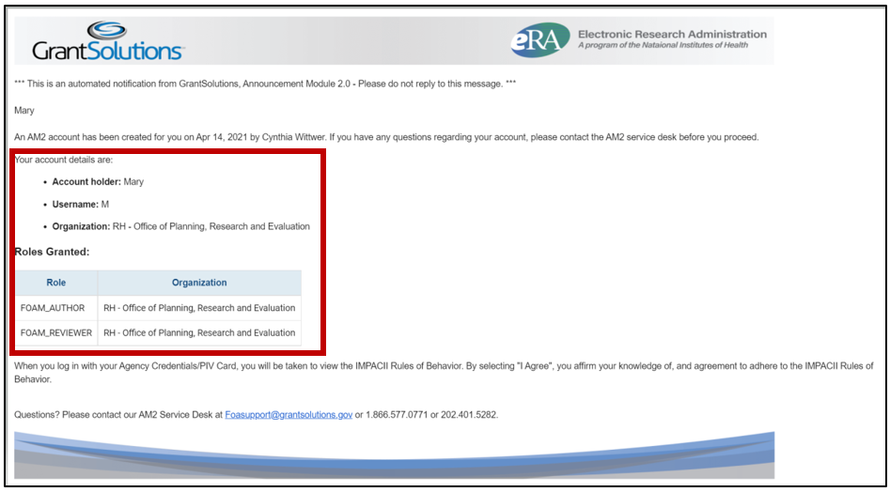
Email Notification– Announcement Services

Slide 22
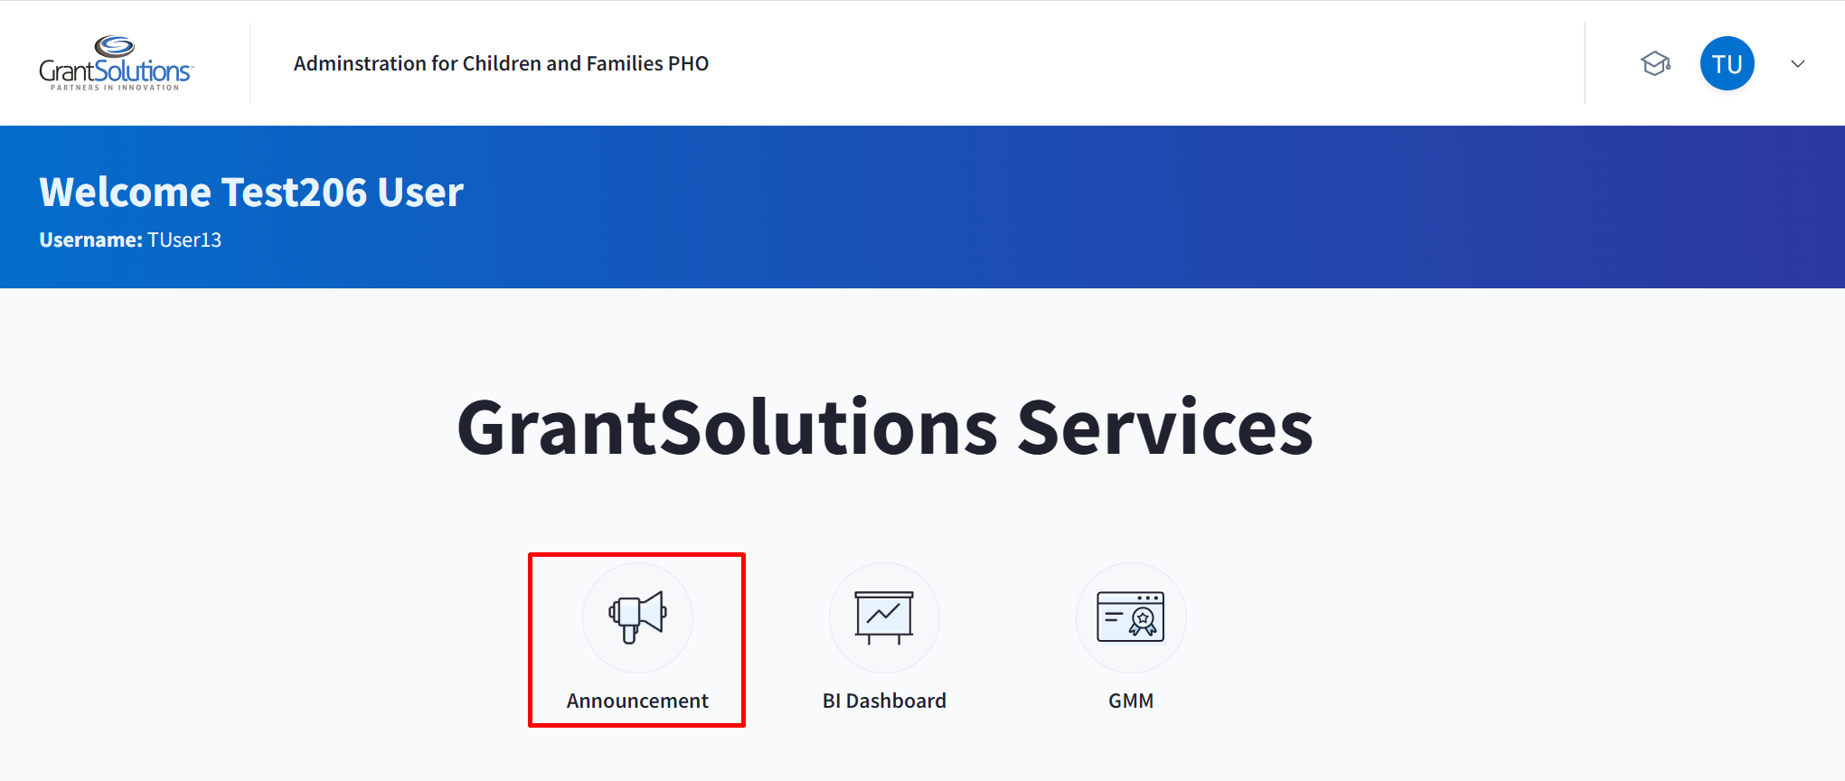
Activate Account – Announcement Services

Slide 23
General Information
Post Training you will receive via email:
  Role Specific Quick Reference Guide
The GrantSolutions Help Desk is available to provide technical assistance
  Monday – Friday 7 AM to 8 PM Eastern Time
    Excluding Federal Holidays
  Email: foasupport@grantsolutions.gov

Slide 24
Thanks for attending this training!

