Slide 1
SAP DATASPHERE INTEGRATION PATTERNS
Sai Krishna Kalivarapu
Senior Manager, National Bank of Canada
Livia Ferraz
SAP BI Analyst, National Bank of Canada

Slide 2
Agenda
Overall integration architecture
Pattern 1 | A three-layer Datasphere architecture
Pattern 2 | S/4HANA Private Cloud to Datasphere
Pattern 3 | SAP Ariba Integration Using CAP and SAP Integration Suite
Pattern 4| File-Based Integration Using SFTP and SAP Integration Suite
Key Lessons Learned
Pattern 5| Kafka Event Streaming Integration

Slide 3
SAP Datasphere Journey
December 2024
SAP Datasphere environment established
June 2025
Return on Equity (RoE) solution deployed
November 2026 | Planned
Ariba data integrated with Finance General Ledger data
March 2026
SAP Datasphere transitioned to SAP Business Data Cloud (BDC)
March 2026
Organizational transactional data deployed and integrated with SAP S/4HANA Finance
April 2026
Ariba data integrated into SAP Datasphere through a CAP application
October 2025
RNI solution deployed

Slide 4
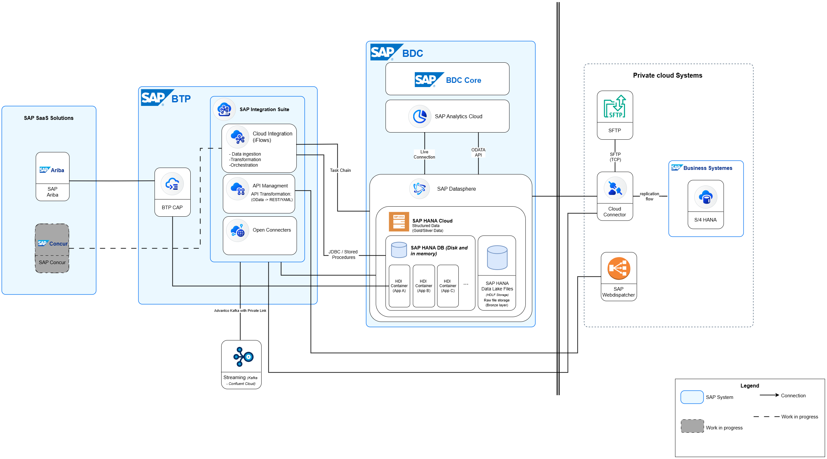
ARCHITECTURE
The integration landscape at a glance
Key integration patterns that we have successfully implemented around SAP Datasphere.
Architecture is a decision, not a default
Notes:
[Sources]
- Architecture visual reused from the presenter-supplied original deck.
[/Sources]

Slide 5
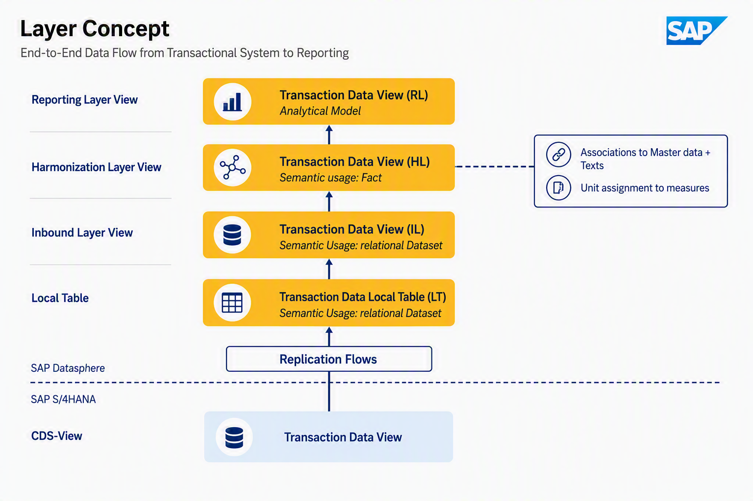
PATTERN 1
A three-layer Datasphere architecture
Separate ingestion, harmonization, and reporting in layers.
Local / inbound
Land data close to the source structure; preserve traceability.
Harmonized
Standardize semantics and reusable business logic.
Reporting
Expose consumption-ready views and analytical models.
Notes:
[Sources]
- Three-layer architecture visual reused from slide 9 of the presenter-supplied original deck.
[/Sources]

Slide 6
PATTERN 2
S/4HANA Private Cloud to Datasphere
Why replication became the default for high-volume Finance analytics.
Options evaluated
SAP business content • Custom CDS views • Remote tables • Replication flows
S/4HANA
Replication Flow
Datasphere
Analytics
Source
Move
Persist
Consume
Decision
Use Replication Flows for most Finance use cases to reduce source runtime dependency and improve reporting performance.
Performance is an end-to-end chain
Optimize end to end
01 DATASPHERE
Partition large datasets
for faster loads
02 SAP HANA
Optimize CDS view
execution
03 INFRASTRUCTURE
Scale Cloud Connector
capacity
Partition large financial tables • Optimize CDS/HANA execution • Scale Cloud Connector and network throughput
Notes:
[Sources]
- Pattern content adapted from slide 5 of the presenter-supplied original deck.
[/Sources]

Slide 7
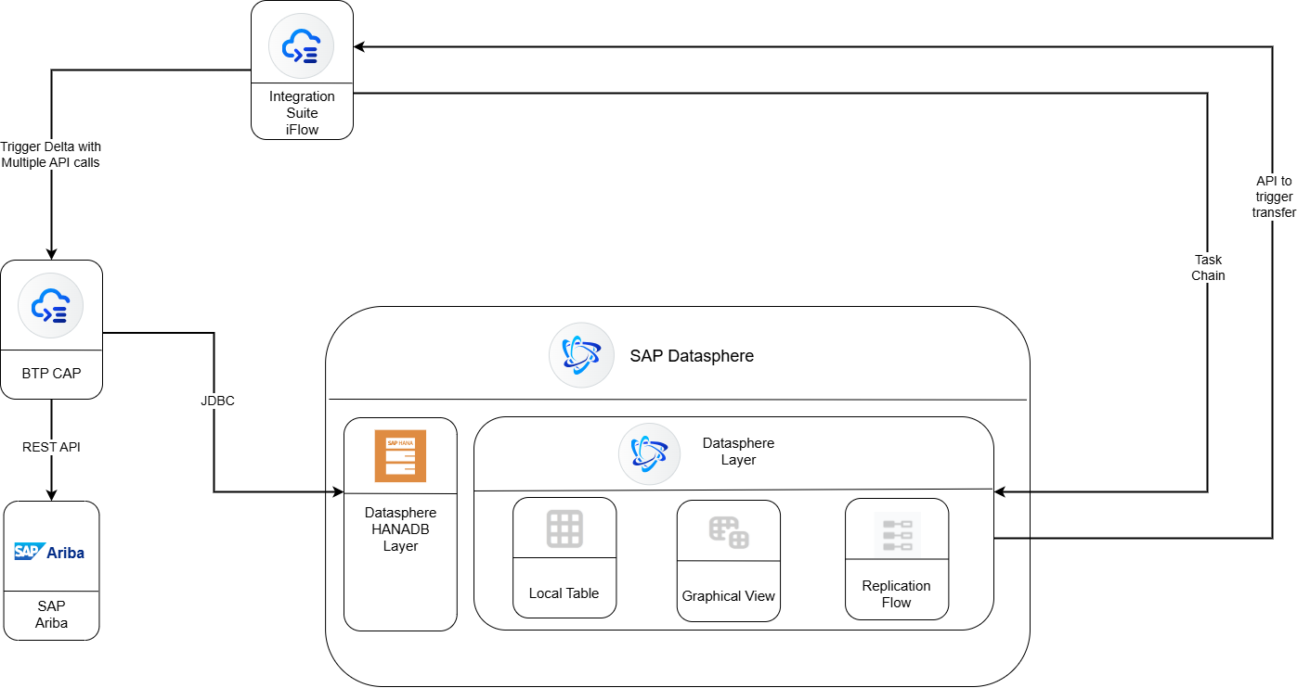
PATTERN 3
SAP Ariba integration using CAP and Integration Suite
Standard content accelerated the baseline; enterprise requirements shaped the implementation.
1
Extract via CAP services
2
Create and monitor jobs
3
Download extracted datasets
4
Transform and enrich
5
Upsert into Datasphere HDI
6
Trigger downstream processing
Notes:
[Sources]
- Ariba architecture visual and process adapted from slide 8 of the presenter-supplied original deck.
[/Sources]

Slide 8
PATTERN 4
File-based integration using SFTP and Integration Suite
01
02
03
File-Based Integration Using SFTP
- We integrated Datasphere with SFTP sources through Cloud Connector.
SAP Integration Suite
- For these scenarios, SAP Integration Suite played a critical role in:
• Flattening nested JSON structures
• Data cleansing and transformation
• Field mapping
• Exception handling
• Handling Encrypted Files
After transformation, data was loaded directly into the Datasphere HANA database layer using the JDBC adapter.
Notes:
[Sources]
- Pattern content adapted from slide 6 of the presenter-supplied original deck.
[/Sources]

Slide 9
PATTERN 5
Kafka event streaming integration
For production deployments, we leveraged the SAP Integration Suite Advantco Kafka Adapter.
This architecture provided:
Private
Connectivity
PGP Decryption
Message Transformation
Operational Monitoring
Centralized
Governance
Secure connectivity through private network channels, avoiding exposure to public internet.
Automated decryption of inbound messages to support secure data exchange.
Transform and map event payloads between source and target formats.
Centralized visibility into message processing, errors, and integration health.
Consistent security, auditing, and policy enforcement across integrations.
The additional integration layer increased architectural flexibility while meeting enterprise security and compliance standards.
Notes:
[Sources]
- Pattern content adapted from slide 7 of the presenter-supplied original deck.
[/Sources]

Slide 10
Key Lessons Learned
After implementing these integration patterns across multiple projects, several key lessons emerged:
There is no single integration approach that fits every use case.
01
SAP S/4HANA Cloud Private Edition
Replication Flows are often the preferred option for large-volume analytical workloads where performance and scalability are critical.
Infrastructure sizing, particularly for Cloud Connector and network throughput, should be considered early in large-scale implementations.
02
SAP Ariba Integration Using CAP and SAP Integration Suite
Standard SAP-delivered content accelerates implementation but often requires customization to meet enterprise-specific requirements.
File-Based Integration Using SFTP, SAP Integration Suite and Kafka
SAP Integration Suite becomes increasingly valuable when orchestration, security, transformation, and monitoring requirements grow.
03

Slide 11
THANK YOU
Questions and discussion
Sai Krishna Kalivarapu
Senior Manager, National Bank of Canada
Livia Ferraz
SAP BI Analyst, National Bank of Canada

